Slide 1

Elements
and
Compounds
ELEMENTS
AND COMPOUNDS
NPS/NAFL NORTH
5
NPSNAFLNORTH|KOCL|May2021

Slide 2
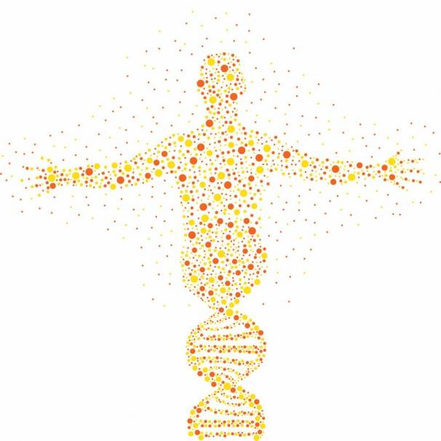
Contents
Atoms and Molecules Page 3
Elements and Compounds Page 8
Molecules Page 9
Compounds Page 10
Mixtures Page 11
The Changes of States of Matter Page 15
Introduction to the Periodic Table Page 23
Activity Page 25
Vocabulary Page 27

Slide 3
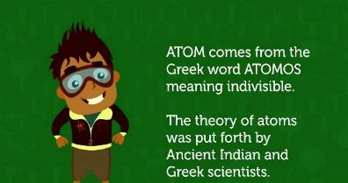
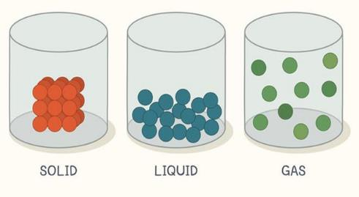
Atoms And Molecules
ATOMS AND MOLECULES
Matter
Everything that we can touch, see and feel is made up of matter. Even air is made up of matter. Matter is anything that has mass and occupies space.
Some examples of matter are wood, water and air.
Matter is found in 3 states:
• Solid
• Liquid
• Gas
Go back to the contents page
Page | 3

Slide 4
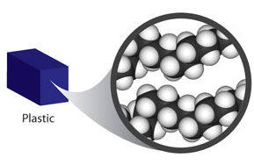
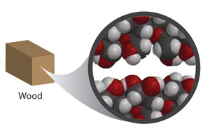
Matter
Matter is made up of extremely small particles called molecules.
Different substances are made up of different kinds molecules. Every molecule of a substance shows the properties of that substance. Hence, the molecules of one substance are different from the molecules of another substance.
Go back to the contents page
Page | 4

Slide 5
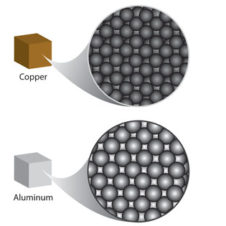
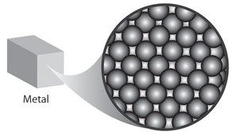
Matter
Not only man-made things like metals or cars, but even the dust floating in the air, dew drops that settle on the grass, blue whales of the oceans, germs that cause diseases and the mighty sun are made up of molecules.
Go back to the contents page
Page | 5

Slide 6
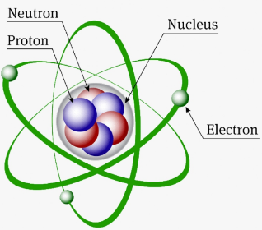
Matter
Atoms
Atoms are the "building blocks" that make up EVERYTHING!
Atoms are very, very small. They are so small that they can only be seen under a special microscope called an electron microscope. They are so small that millions of them could fit on the head of a pin. There are different kinds of atoms.
Molecules
When two or more atoms combine and join, they create a molecule.
Molecules can be made from the same kind of atoms or combinations of different atoms. All molecules are made from atoms, but they look different because of the way they are put together.
Go back to the contents page
Page | 6

Slide 7
Matter
Look at the pictures below: They are made of atoms but are put together differently.
O
C
H
Atom
Molecules
- Combinations of different atoms
Oxygen
Carbon
Hydrogen
O
H
O
C
H
O
O
O
H
H
O₂
_{Oxygen Molecule}
CO₂
_{Carbon-dioxide Molecule}
H₂O
_{Water Molecule}
H₂
_{Hydrogen Molecule}
Some molecules have a small 2 after a letter which means it has two atoms in it.
Go back to the contents page
Page | 7

Slide 8
Elements And Compounds
ELEMENTS AND COMPOUNDS
What is an element?
A substance that is made up of a single type of atom is called an element. Oxygen, chlorine, gold, hydrogen and carbon are examples of elements.
Some elements like iron, gold, silver and copper are metals while some like carbon, oxygen and nitrogen are not metals.
Atoms found in one element are not found in any other element.
Every kind of atom has its own unique properties. That is why every element is different from all other elements. For example, the element gold is different from every other element.
Fe
Symbol for Iron
Page | 8
Go back to the contents page

Slide 9
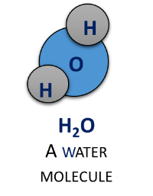
Compounds
COMPOUNDS
The molecules of some substances are made up of more than one type of atom. Such substances are called compounds.
Water is a compound. The water molecule is made up of two different types of elements - Hydrogen and Oxygen.
Two Hydrogen atoms and one Oxygen atom join together to form a molecule of water. The molecule of a compound is its smallest part. It has all the properties of a compound.
A molecule of water has all the properties of water. Carbon dioxide, table salt and sugar are examples of some other compounds.
Do you know why a compound is different from the elements, that make it?
Go back to the contents page
Page | 9

Slide 10
Compound
A compound is made up of atoms of more than one type of elements. You know that water is a liquid. It is made up of two different types of elements—Hydrogen and Oxygen.
Hydrogen and Oxygen are gases at room temperature. Hydrogen is a gas that burns easily, whereas Oxygen supports the process of burning.
Water is not like either of the elements it is made up of. This is true in the case of all compounds. A compound is always different from the elements that make it.
O
H
CO₂
_{Carbon-dioxide Molecule}
C
H₂O
_{Water Molecule}
O
H
O
Go back to the contents page
Page | 10

Slide 11
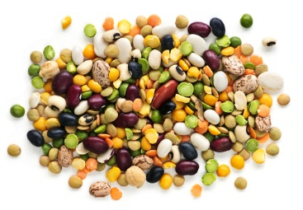
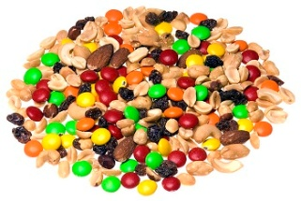
Mixtures
MIXTURES
A mixture is a substance made up of two or more elements or compounds when physically mixed in any ratio.
Ice-cream, sugar syrup, salt solution, smoke, ink and paints are a few examples of mixtures.
Mixture of grains
Mixture of gems, groundnuts and seeds
Go back to the contents page
Page | 11

Slide 12
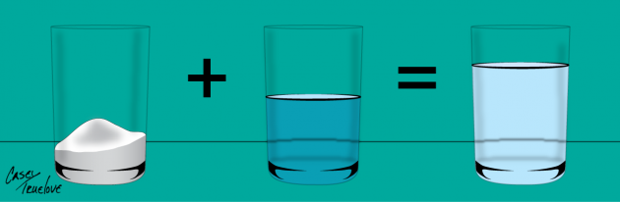
Characteristics Of Mixtures
The constituents in a mixture may be present in any ratio or proportion.
For example, in a mixture of salt and water, the amount of salt and water is not fixed. A mixture of salt and water can be prepared with one, two or more spoons of salt. Irrespective of the number of spoons of salt, the combination of water and salt is still a mixture.
mixture of salt and water
Salt
Water
Mixture
Go back to the contents page
Page | 12

Slide 13
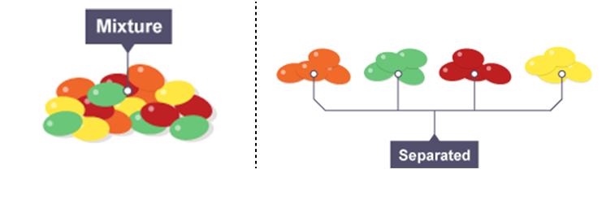
Characteristics Of Mixtures
A mixture does not have any specific property of its own. In a mixture, each constituent exhibits its original properties.
For example, pure oxygen supports burning and so does the oxygen present in air. Similarly, the taste of salt is salty on its own, and it also tastes salty when mixed with water.
A mixture does not have a fixed melting or boiling point.
Go back to the contents page
Page | 13

Slide 14
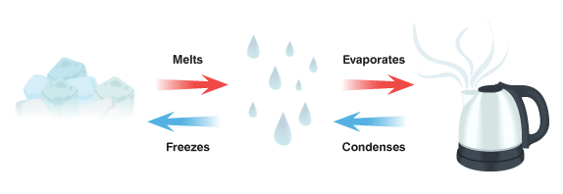

Changes Of States Of Matter
Heating and cooling can change the arrangement of molecules in a substance and thereby its state.
On heating, molecules move further apart and a solid changes to a liquid and a liquid into a gas.
Just the opposite happens when a substance is cooled. The molecules move closer and so a gas changes into a liquid and a liquid into a solid.
Condenses
Go back to the contents page
Page | 15

Slide 15
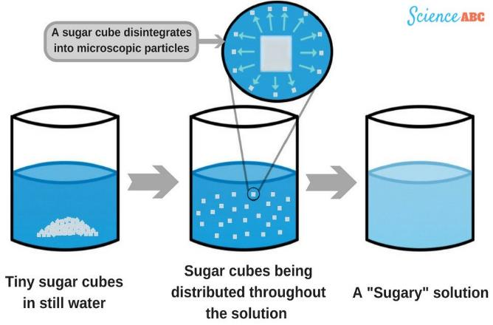

Solution
A solution is formed when a substance dissolves in a liquid.
For example, sugar dissolves in water and forms a solution of sugar and water. Similarly, honey and water form a solution.
Go back to the contents page
Page | 16

Slide 16
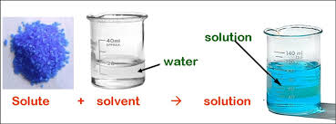
Solution And Solvent
A solution is formed when a substance dissolves in a liquid.
The substance which dissolves in the liquid is known as a solute. The liquid in which the solute dissolves is called the solvent. When salt is added to water, a salt solution is formed. Salt is the solute and water is the solvent
Go back to the contents page
Page | 17

Slide 17
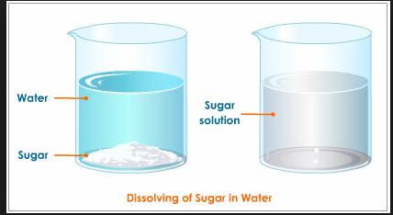
Solids In Water
Substances like salt and sugar that dissolve in water are said to be soluble in water.
Substances like sand and chalk powder that do not dissolve in water are said to be insoluble in water.
Go back to the contents page
Page | 18

Slide 18
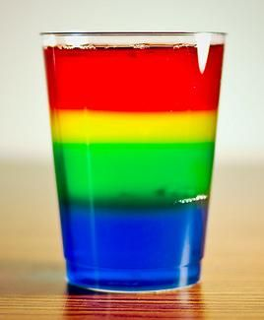
Liquids In Water
Immiscible Liquids
When two liquids mix together, they are called miscible liquids. Eg. Honey and water are miscible liquids.
Some liquids do not dissolve in water. For example, cooking oil and water do not mix.
Such liquids are called immiscible liquids.
Go back to the contents page
Page | 19

Slide 19
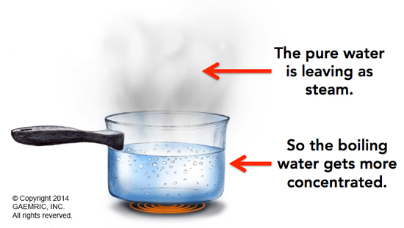

Gases In Water
Gases like oxygen and carbon dioxide dissolve in water.
Most aquatic animals like fish breathe in oxygen that is dissolved in water.
Aquatic plants like hydrilla take in carbon dioxide dissolved in water.
Go back to the contents page
Page | 20

Slide 20
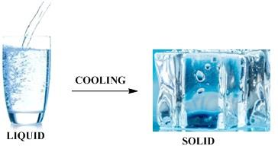
Changes Around Us
The world around us changes continuously. Changes are of two types- physical and chemical.
Physical change: A physical change is a temporary change. It does not result in the formation of a new substance as the properties of the substance do not change.
For example, the formation of a salt solution is a physical change because both salt and water can be easily separated.
Go back to the contents page
Page | 21

Slide 21
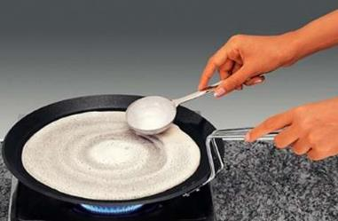
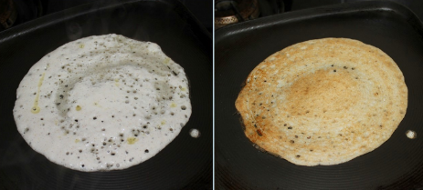
Chemical Change
A chemical change forms one or more new substances. A chemical change is mostly irreversible and permanent.
For example, if sugar is heated continuously, it changes into a new black substance. The new substance formed is carbon. It does not have the properties of sugar. Similarly burning of paper brings about a chemical change. The paper is reduced to ash. Ash cannot be converted into paper again.
dosa batter changed into dosa
Go back to the contents page
Page | 22

Slide 22
Introduction To The Periodic Table
INTRODUCTION TO THE PERIODIC TABLE
1
Some elements like iron, gold, silver and copper are metals while some like carbon, oxygen and nitrogen are not metals.
Atoms found in one element are not found in any other element.
Every element has a specific name given by the International Union of Pure and Applied Chemistry (IUPAC).
Since there are numerous elements, it is easy to refer to them using symbols rather than their full names all the time.
Most elements are obtained from nature, there are 92 naturally occurring elements.
Only a few can be made in the laboratory by scientists and these man-made elements can only be made in very small quantities.
2
3
4
5
6
Go back to the contents page
Page | 23

Slide 23
Some Common Elements And Their Symbols
Elements | Symbols
Aluminium | Al
Bromos (Greek) - Bromine | Br
Chlorine | Cl
Cobalt | Co
Cuprum (Latin) - Copper | Cu
Ferrum (Latin) - Iron | Fe
Helium | He
Hydrogen | H
Iodine | I
Kalium (Latin) - Potassium | K
Magnesium | Mg
Natrium (Latin) - Sodium | Na
Sulphur | S
Go back to the contents page
Page | 24

Slide 24
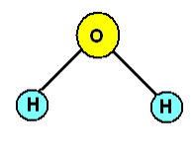
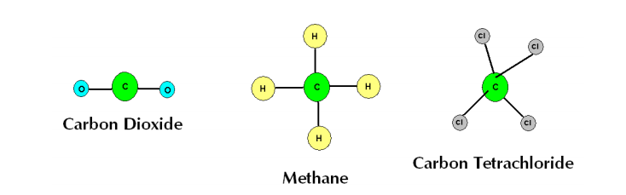
Activity
ACTIVITY
1
Make models of molecules with toothpicks and coloured balls of clay. Start with a water molecule. Choose a colour to be oxygen and a colour to be hydrogen. Attach the two hydrogen balls to the oxygen ball with the toothpicks so it looks like this diagram:
2
After you have finished making the water molecule, make these molecules:
Go back to the contents page
Page | 25

Slide 25
Activity
From the activity we can see that “di” means two, so carbon dioxide means a carbon molecule with two oxygen molecules. “Tetra” means four, so carbon tetrachloride means a carbon molecule with four chlorine molecules.
Info Zone
Oxygen is an element. It usually occurs as oxygen gas and ozone gas. Being an element, it is made up of only one type of atom. But the molecules of oxygen and ozone are different. The oxygen molecule is made up of two atoms of oxygen whereas the ozone molecule has three atoms of oxygen.
Go back to the contents page
Page | 26

Slide 26
Vocabulary
VOCABULARY
compound-a substance whose molecules are made up of more than one type of atom
element-a substance that is made up of a single type of atom
mixture-a substance that is made up of two or more elements or compounds when physically mixed in any ratio
molecule-the smallest part of an element that has all its properties
Go back to the contents page
Page | 27

